Slide 1

Smart Dustbin

Slide 2

SUPPORTING FACULTIES AND TEAM MEMBERS
DR. M. SAFA , Assistant Professor / NWC
Shaurya Singh Srinet, RA2111032010006 / NWC
Shounak Chandra, RA2111032010026 / NWC
Parth Galhotra, RA2111032010029 / NWC

Slide 3


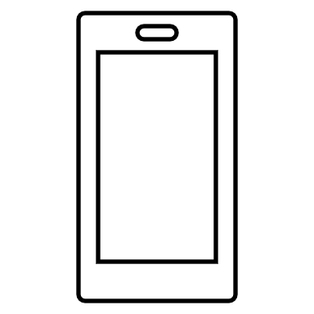
INTRODUCTION
Waste management is a critical challenge in urban environments. The Smart Dustbin project aims to tackle this issue by employing innovative technology to facilitate efficient and hygienic waste disposal.

Slide 4



OBJECTIVE
To design and implement a scalable Smart Dustbin system that:
Encourages hands-free operation to maintain hygiene.
Monitors fill levels for timely waste collection.
Sorts waste to promote recycling.
Reduces operational costs of waste management.
Engages users through IoT connectivity and interactive features.

Slide 5



METHODOLOGY
Develop a prototype Smart Dustbin equipped with an ultrasonic sensor for automated lid operation.
Integrate secondary sensors for real-time fill level monitoring.
Employ a solar-powered battery system for energy efficiency.
Implement Blynk IoT app connectivity for user notifications and remote monitoring.
Design an interactive user interface to engage users and promote environmental awareness.

Slide 6

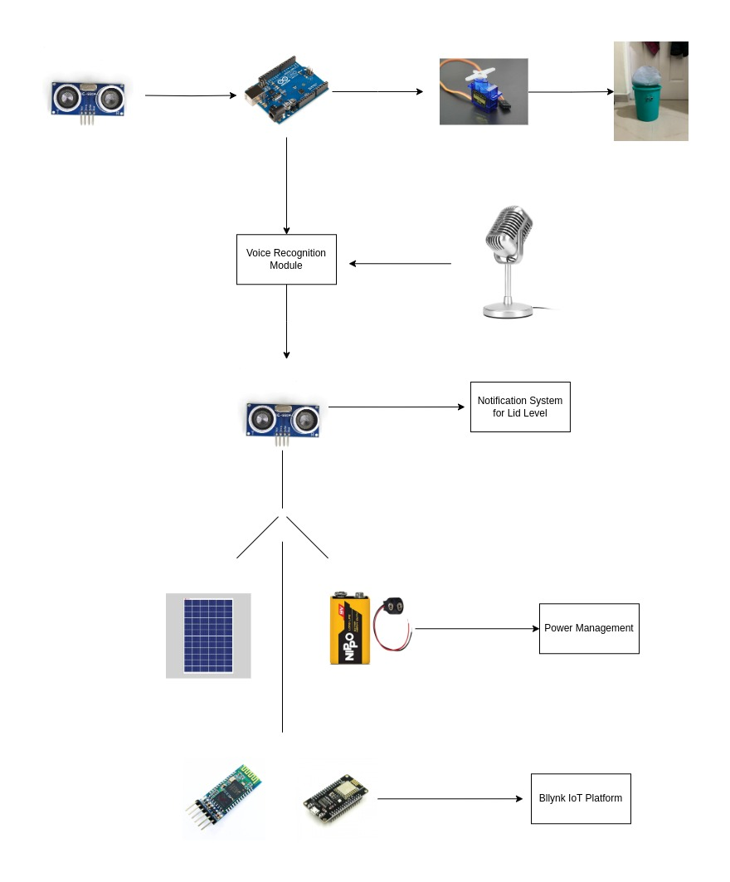
ARCHITECTURE DIAGRAM

Slide 7



SCOPE
Designing and developing a network of smart, automated dustbins.
Implementing a waste sorting protocol to facilitate recycling.
Establishing a real-time monitoring system for waste management.
Deploying IoT connectivity for data analysis and user engagement.
Creating an educational campaign to promote sustainability practices.

Slide 8
WORKING
An ultrasonic sensor detects a user approaching and signals the Arduino controller.
The Arduino activates a servo motor, which opens the dustbin lid automatically.
The user disposes of the waste without touching the bin, maintaining hygiene.
Once the user leaves, the sensor signals the controller again after a short delay, and the servo motor closes the lid.
A secondary sensor measures the fill level, signaling when the dustbin is nearly full through a LED/buzzer system and sending notifications via the Blynk IoT app.

Slide 9
WORKING
5. Users can interact with the system through voice commands, recognized by a voice module connected to the Arduino, allowing for hands-free operation even if the user is not approaching the bin.
6. Solar panels attached to the system charge a battery, ensuring a sustainable and uninterrupted power supply.

Slide 10

CONCLUSION
The Smart Dustbin system presents a forward-thinking solution to waste management challenges.

Slide 11
HARDWARE COMPONENTS
1. ARDUINO UNO 2. SERVO MOTOR
3. UTRASONIC SENORS 4. SOLAR PANEL
5. LED INDICATOR/BUZZER 6. RECHARGEABLE BATTERIES
7. BLUETOOTH/WI-FI MODULE 7. VOICE RECOGNITION MODULE

Slide 12
THANK YOU

